Slide 1
第三组第11周展示
黄鲸慧 宗冰蕊 林灏 周宸宇
郭亦凡 宁微希 雷怡然 龙行明

Slide 2
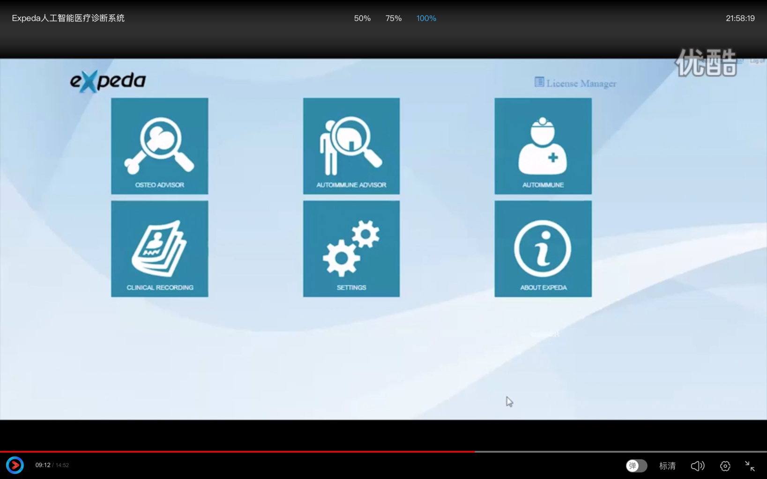
Expeda人工智能医疗诊断系统
From: http://v.youku.com/v_show/id_XMTUyMzY1OTU4MA==.html?spm=a2h0k.8191407.0.0&from=s1.8-1-1.2

Slide 3
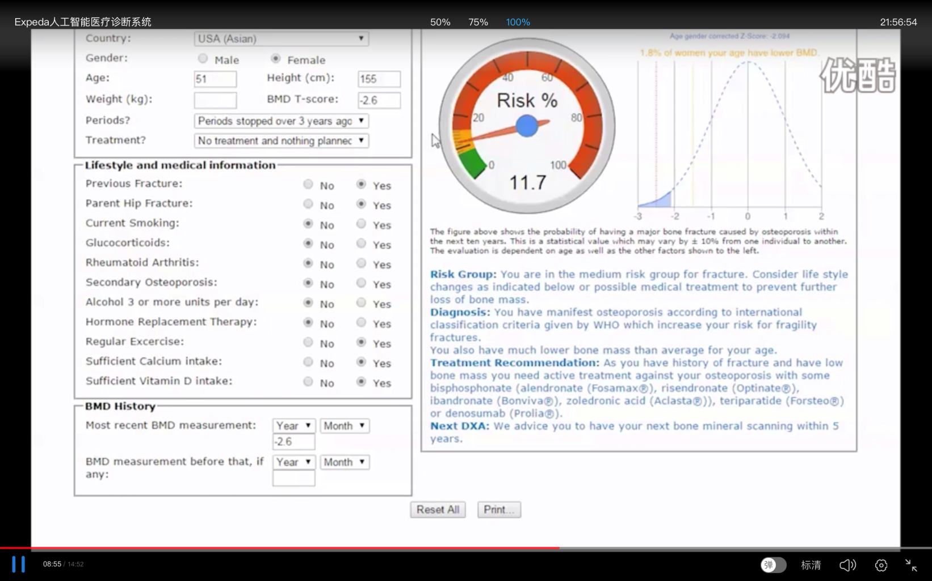
Expeda人工智能医疗诊断系统
From: http://v.youku.com/v_show/id_XMTUyMzY1OTU4MA==.html?spm=a2h0k.8191407.0.0&from=s1.8-1-1.2

Slide 4
Expeda人工智能医疗诊断系统
From: http://v.youku.com/v_show/id_XMTUyMzY1OTU4MA==.html?spm=a2h0k.8191407.0.0&from=s1.8-1-1.2

Slide 5
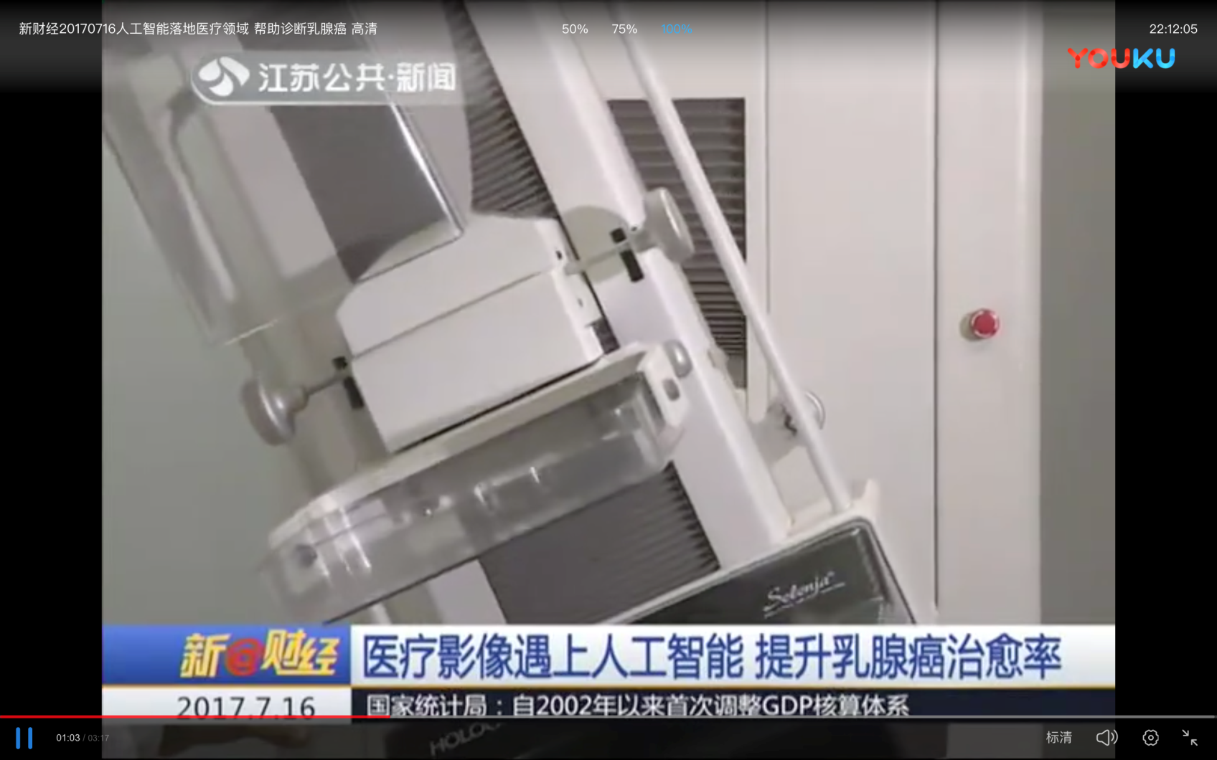
新财经20170716人工智能落地医疗领域
From: http://v.youku.com/v_show/id_XMjg5NjMwODUwMA==.html?spm=a2h0k.8191407.0.0&from=s1.8-1-1.2

Slide 6
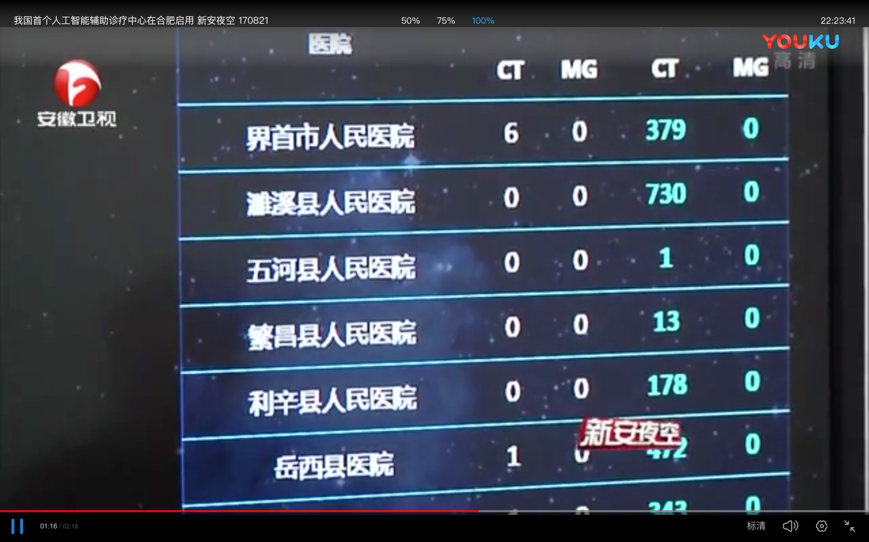
我国首个人工智能辅助诊疗中心在合肥启用
From: http://v.youku.com/v_show/id_XMjk4MjAzNjAxNg==.html?spm=a2h0k.8191407.0.0&from=s1.8-1-1.2

Slide 7
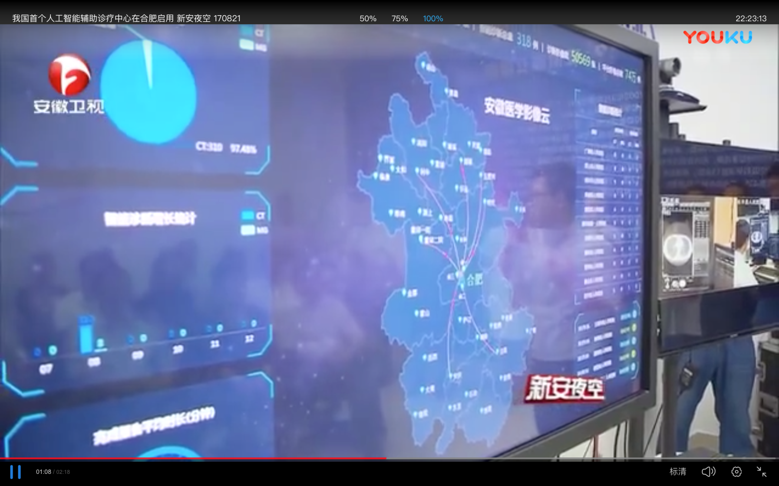
新财经20170716人工智能落地医疗领域
From: http://v.youku.com/v_show/id_XMjk4MjAzNjAxNg==.html?spm=a2h0k.8191407.0.0&from=s1.8-1-1.2

Slide 8
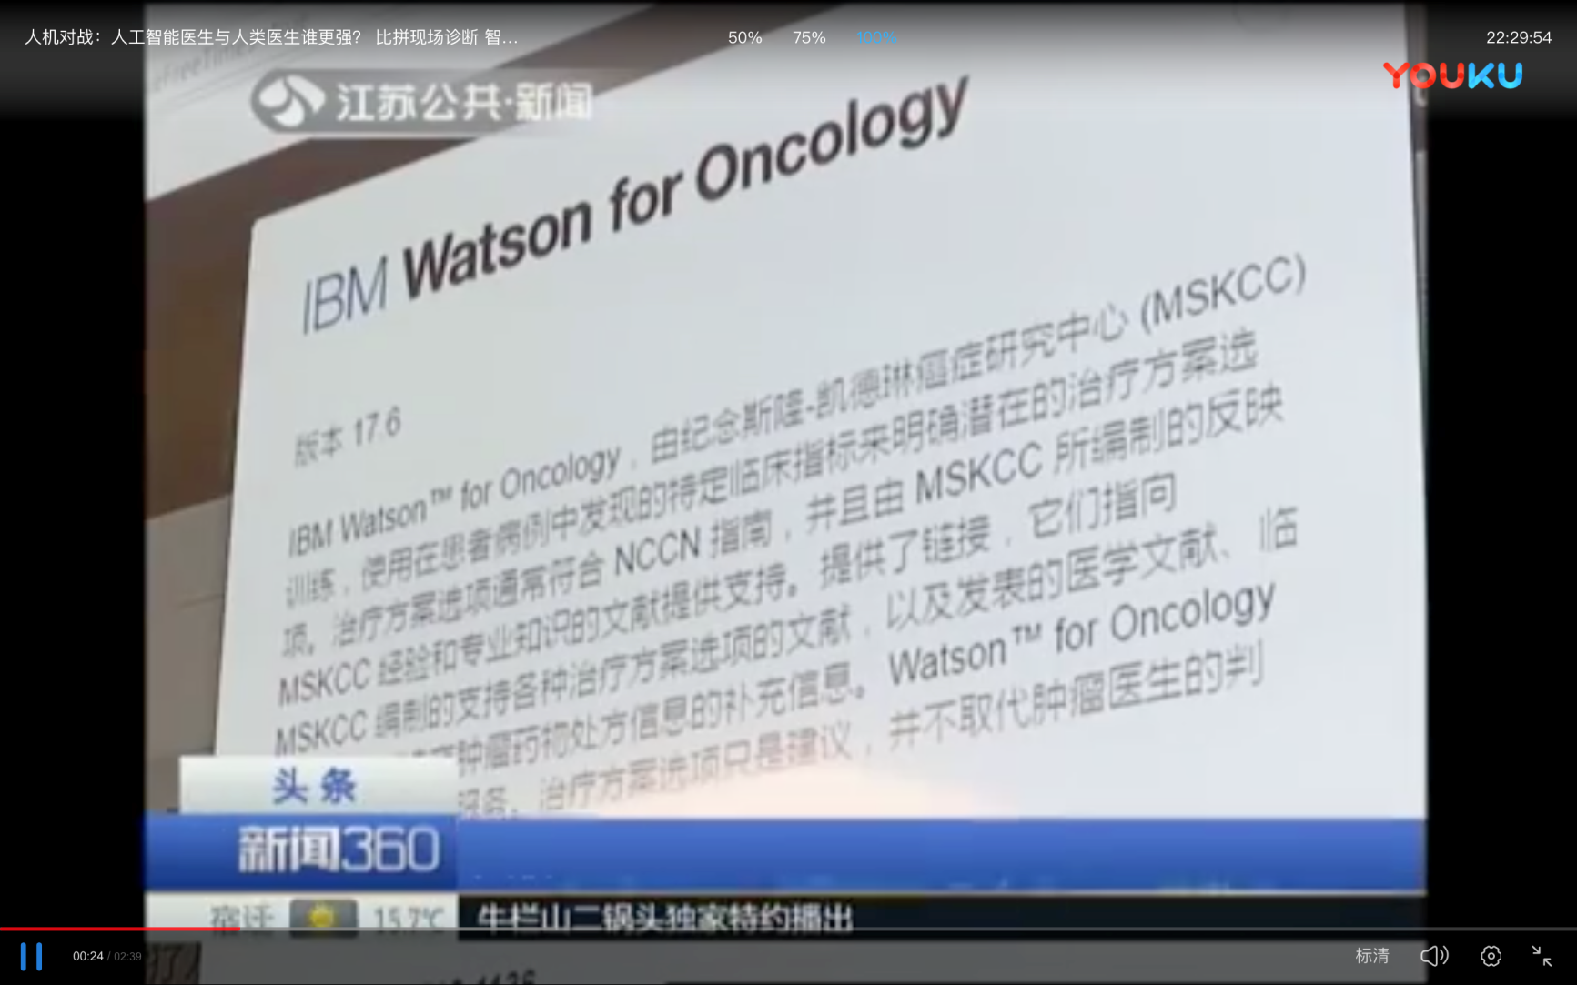
人机对战：人工智能医生与人类医生谁更强
From: http://v.youku.com/v_show/id_XMzEwMDc3NjUzNg==.html?spm=a2h0k.8191407.0.0&from=s1.8-1-1.2

Slide 9
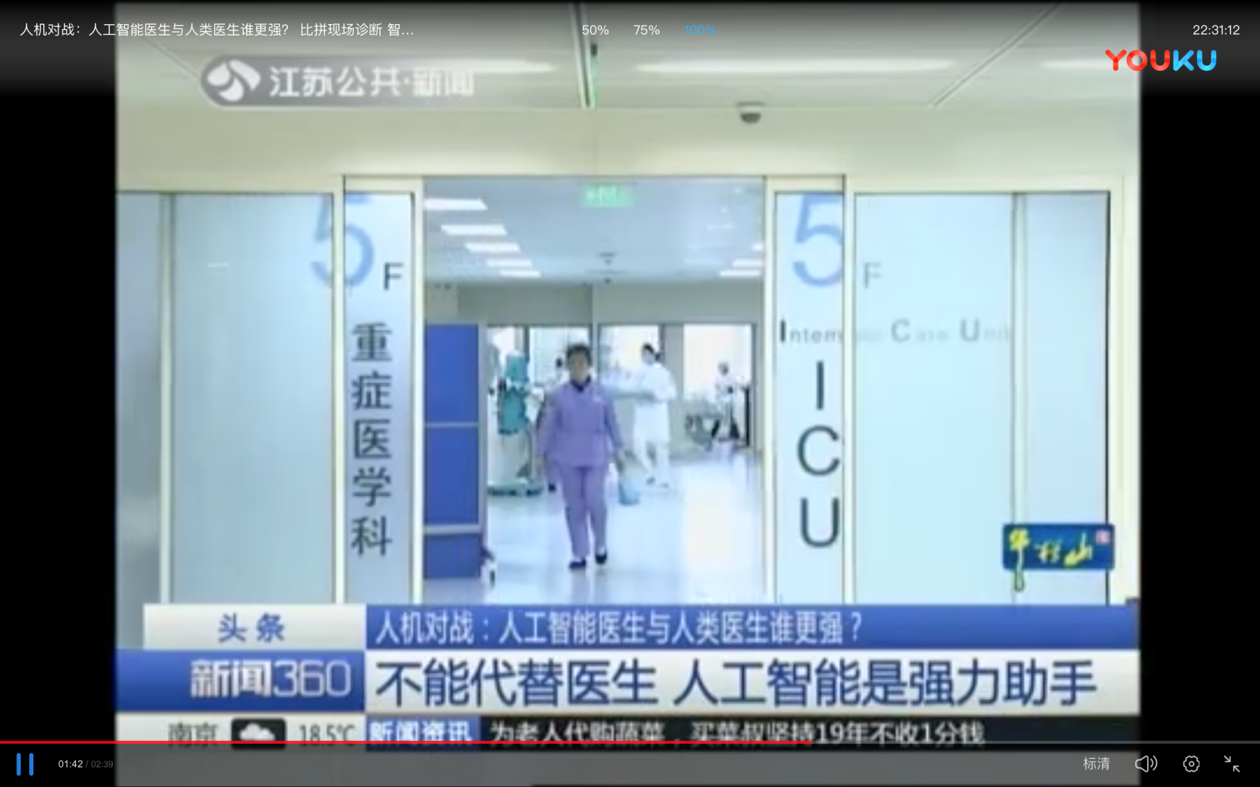
人机对战：人工智能医生与人类医生谁更强
From: http://v.youku.com/v_show/id_XMzEwMDc3NjUzNg==.html?spm=a2h0k.8191407.0.0&from=s1.8-1-1.2

Slide 10
谢 谢

